Slide 1
When Bigger is Not Better… The Unfortunate Tale Of Enormously Large Multiple Sequence Alignments
Cédric Notredame
Center for Genomic Regulation
Barcelona

Slide 2
Darwin’s Finches

Slide 3
Multiple Sequence Alignments

Slide 4
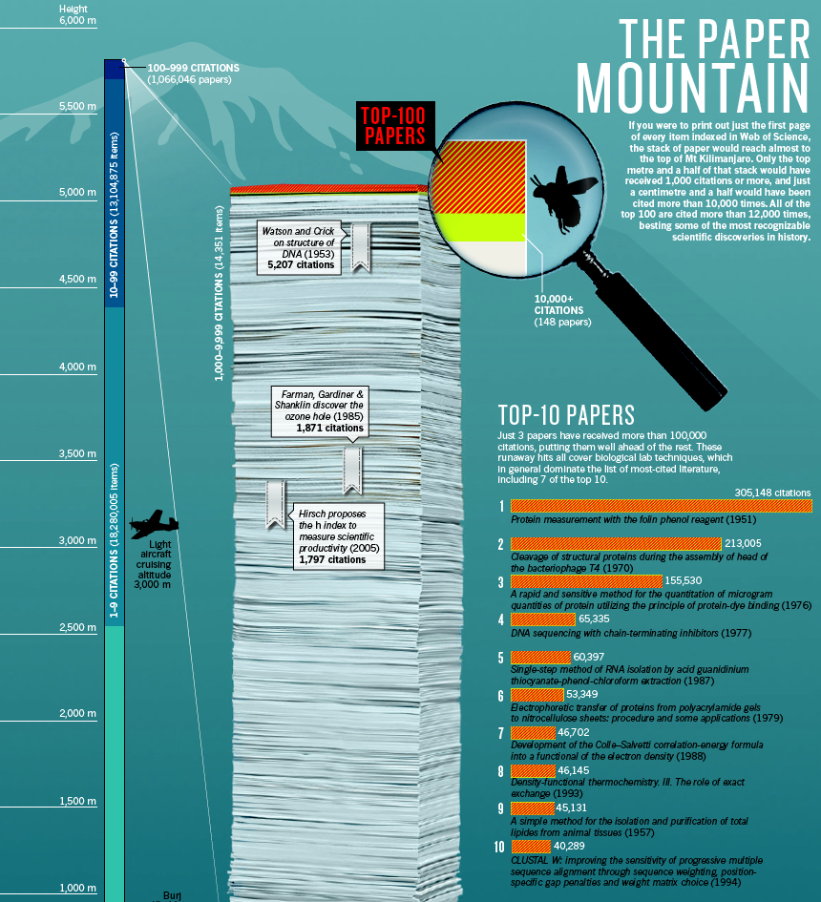
A Multiple Sequence Alignment (MSA) method is the 10th most cited paper EVER!
Notes:
This wide range of usage explains why MSAs have become so popular, with one such software (ClustalW) being among the ten most cited papers in science.

Slide 5
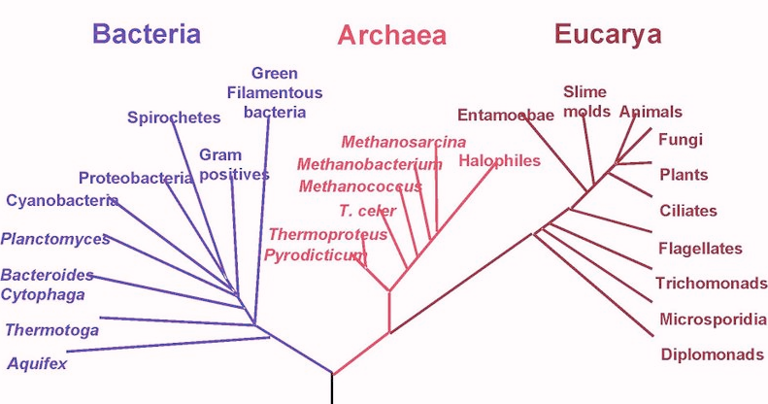
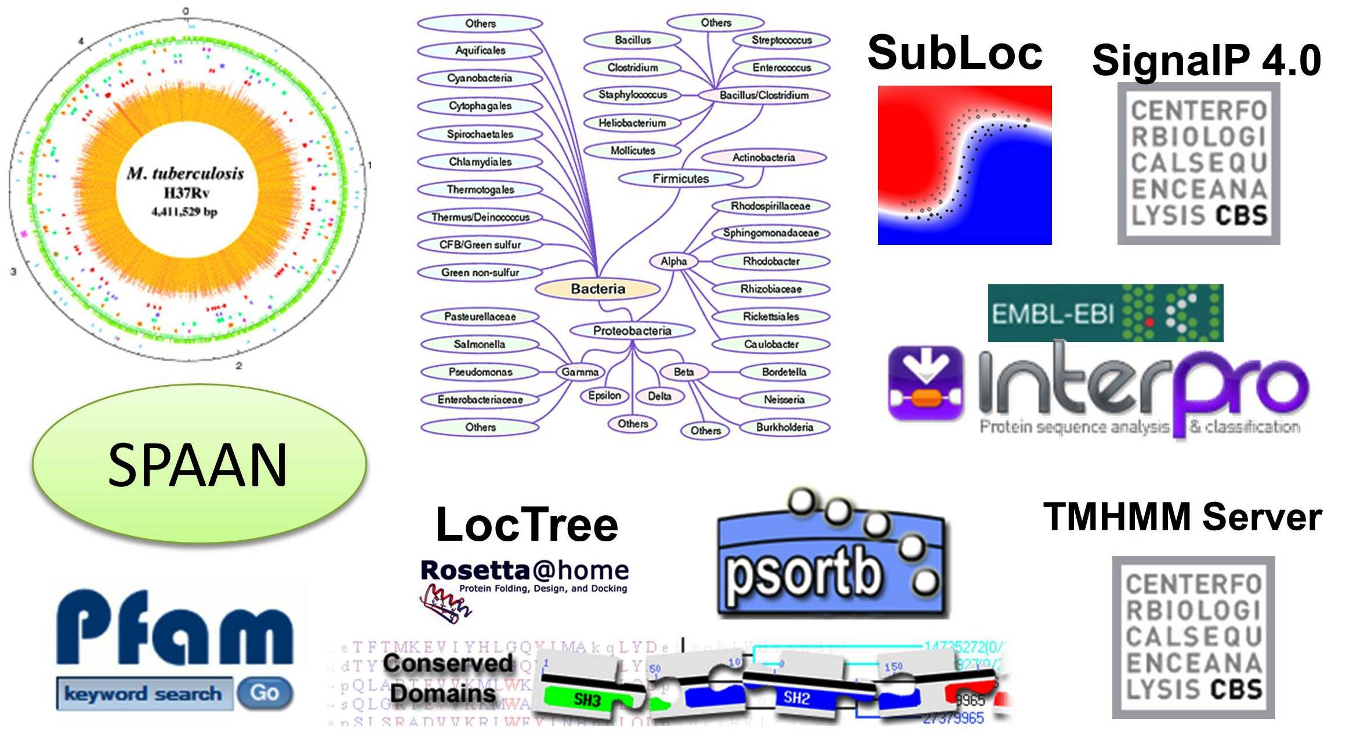
Applications of Alignments
Phylogeny
Mapping
Classification
BLAST

Slide 6
Is it Possible to DO Useful Biology with Large MSAs
?

Slide 7
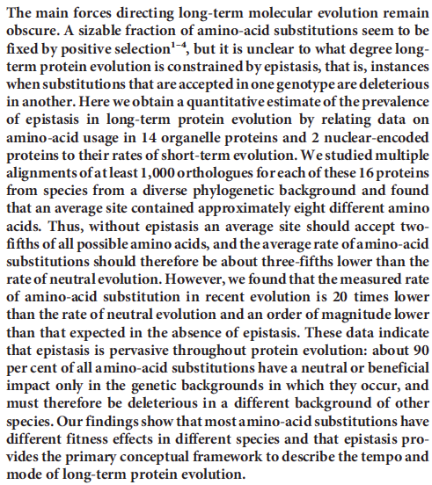

Slide 8
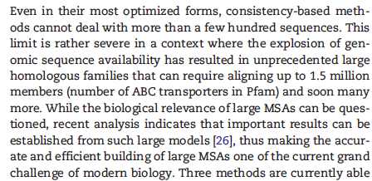
How Big are The BIG MSAs ?

Slide 9
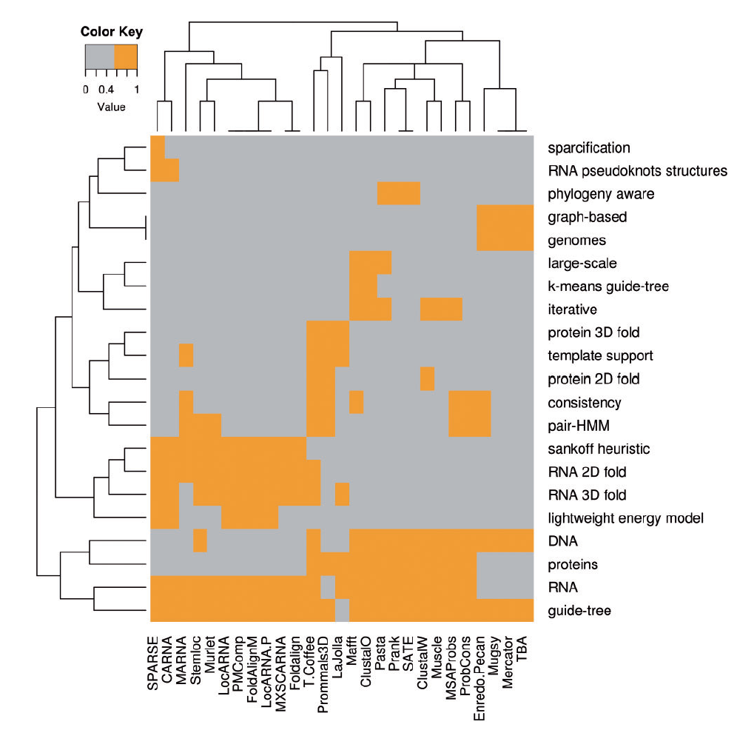
What are The Available Methods ?

Slide 10
How do MSA Aligners Work ?

Slide 11
Dynamic Programming
2 Sequences
Multi-Dimentional
Dynamic Programming
N Sequences

Slide 12
HOW CAN I ALIGN MANY SEQUENCES
2 Globins =>1 Min

Slide 13
HOW CAN I ALIGN MANY SEQUENCES
3 Globins =>2 hours

Slide 14
HOW CAN I ALIGN MANY SEQUENCES
4 Globins => 10 days

Slide 15
HOW CAN I ALIGN MANY SEQUENCES
5 Globins => 3 years

Slide 16
HOW CAN I ALIGN MANY SEQUENCES
! DHEA Loaded
6 Globins =>300 years

Slide 17
HOW CAN I ALIGN MANY SEQUENCES
7 Globins =>30. 000 years
Solidified Fossil, Old stuff

Slide 18
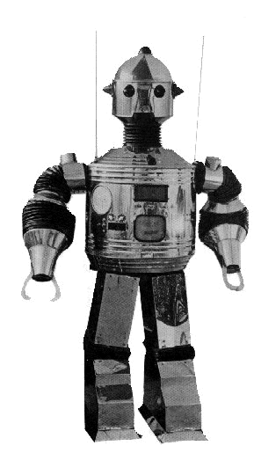
HOW CAN I ALIGN MANY SEQUENCES
8 Globins =>3 Million years

Slide 19
Making An Alignment
Any Exact Method would be TOO SLOW
We will use a Heuristic Algorithm.
Progressive Alignment Algorithm is the most Popular
-ClustalW
-Greedy Heuristic (No Guarranty).
-Fast

Slide 20
Progressive Alignment
Feng and Dolittle, 1988; Taylor 1989
Clustering

Slide 21
Progressive Alignment
Dynamic Programming Using A Substitution Matrix

Slide 22
GARFIELD THE LAST FAT CAT
GARFIELD THE LAST FAT CAT
GARFIELD THE FAST CAT ---
GARFIELD THE FAST CAT
GARFIELD THE LAST FA-T CAT
GARFIELD THE FAST CA-T ---
GARFIELD THE VERY FAST CAT
-------- THE ---- FA-T CAT
GARFIELD THE VERY FAST CAT
GARFIELD THE VERY FAST CAT
-------- THE ---- FA-T CAT
THE FAT CAT

Slide 23
Progressive Alignment
When Does It Work
Works Well When Phylogeny is Dense
No outlayer Sequence.
Image: River Crossing

Slide 24
The Progressive Framework
Should
Work like a Charm
On Very Large Datasets…

Slide 25
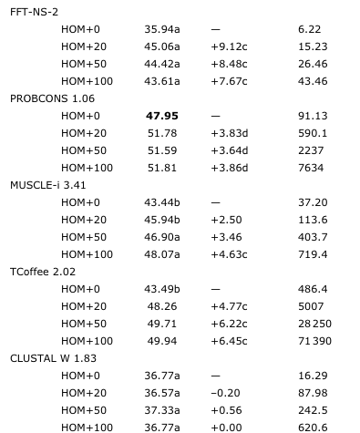
This is what People Thought…

Slide 26
But The Scaling Up Proved Everybody Wrong…

Slide 27
In Biology Things are never so Bad they cannot Become even Worse…
Big Alignments
are not only Inaccurate
they are also Unstable

Slide 28
How do we measure Stability
???
A
A
A A A A A A A A
B
B
B
B
B
B
B
B
B
B
C
C
C
C
C
C
C
C
C
C
A
A
A A A X
X
X
X
X
B
B
B
B
B
A
A A
A
A
C
C
C
C
C
B
B
B
B
B
Method 1
Method 2

Slide 29
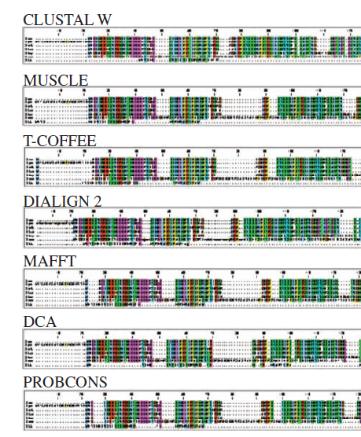
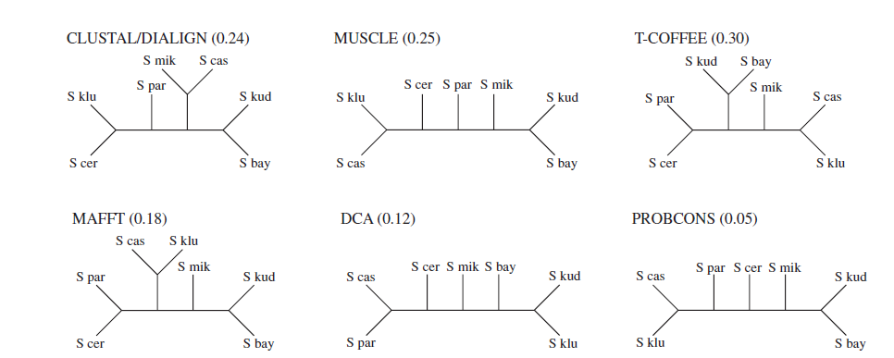
It is Well Known that MSAs are instable across Methods

Slide 30
How About Realigning Sequences While
Changing Input Order
With
THE SAME METHOD
???

Slide 31
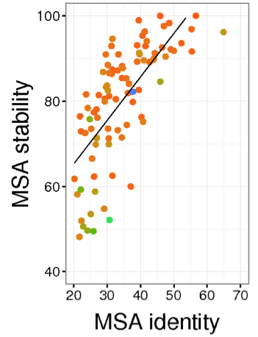
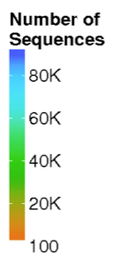
For Each Dataset
-shuffle Sequences
-Align
-Do this a 100 times
Compare the resulting MSAs

Slide 32
Does this have any impact on the underlying
Phylogenetic Trees
???

Slide 33
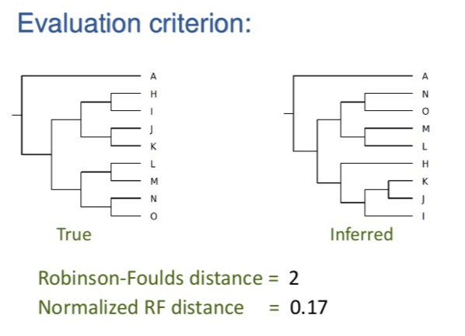
http://www.slideshare.net/jpeterg/seminar-at-georgia-tech-1300049

Slide 34
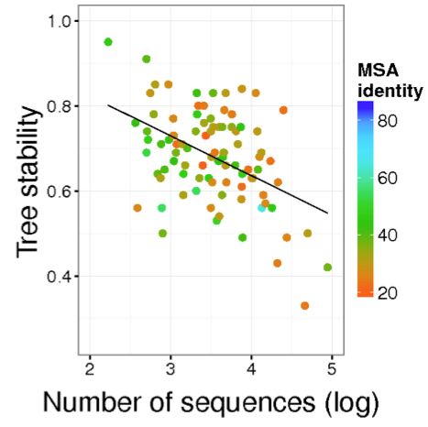

Slide 35
Can we guess what are
The Bad Branches???
This way you would not have to shuffle and re-align the sequences…

Slide 36
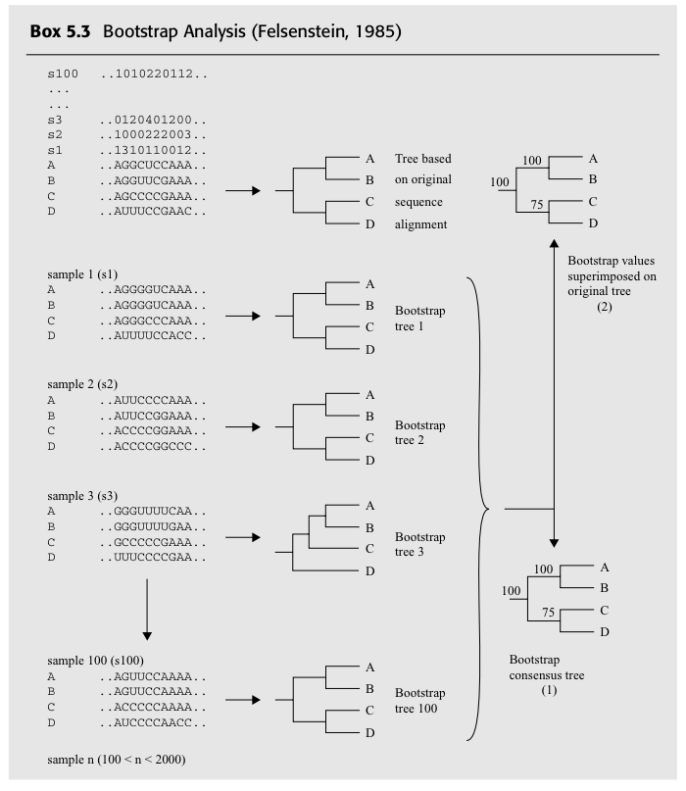
Bootstrap in a Nutshell

Slide 37
Bootstrap in a Nutshell
Global Bootstrap
-One Original MSA
-Draw Replicates
-Estimate Trees
-Compare Them
MSA Support
-Shuffle Sequences
-Estimate MSA
-Estimate Trees
-Compare Them

Slide 38
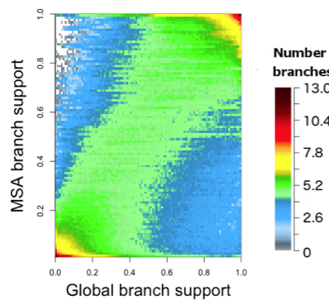
On a large dataset, p450 – 21.500 Sequences

Slide 39
Good News: Good Correlation
Bad News: Computationally Impossible
Estimating the replicate would take months
Alternative: Local Bootstrap ??

Slide 40
Local Bootstrap
On every node, swap the branches (NNI) and measure the variation of ML
It is Fast, but does it say the same as global support?

Slide 41
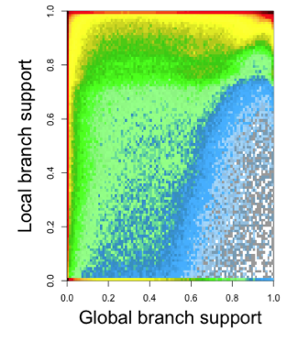
On a large dataset, p450 – 21.500 Sequences

Slide 42
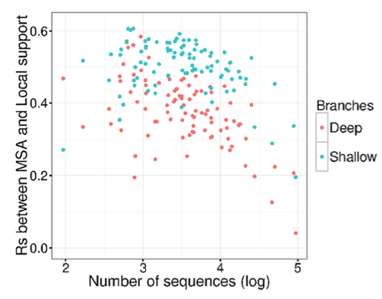
How General is this trend?

Slide 43
Why are the MSAs instable
???

Slide 44
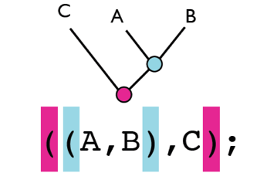
Guide Trees are
Binary Trees
They can be represented with a
Parenthesis format
Aka
Newick Format

Slide 45
In Newick Children Nodes are un-ordered
((A,B),C) ⬄((B,A),C)
These Two Trees are topologically identical
The inside order depends only on the sequence input order

Slide 46
Can these variation affect the final MSA ?
Same
MSA
???

Slide 47
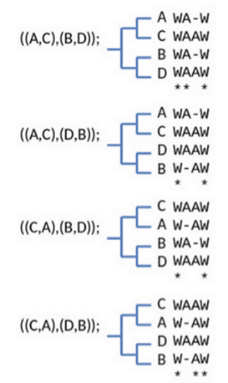
YES!
Same Guide Trees
Different Sequence Input Orders
Different MSAs

Slide 48
Why?
In Most Implementations, Pairwise dynamic programming is order dependent
It delivers one optimal alignment among all the possible
Same Sequences
Same Score
Different order
Different Alignments
WAAW
WA-W
W-AW
WAAW

Slide 49
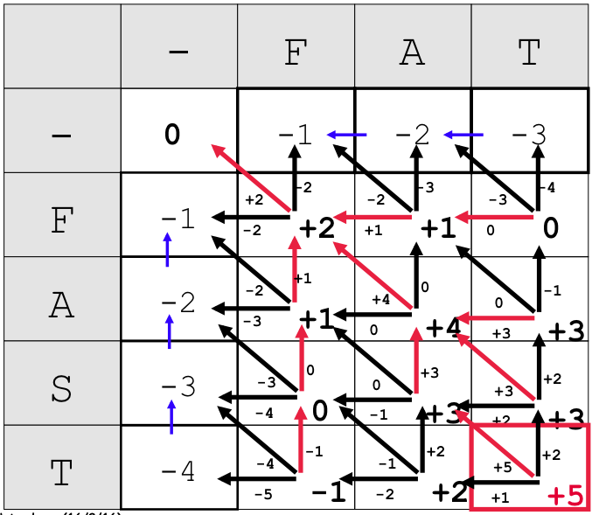
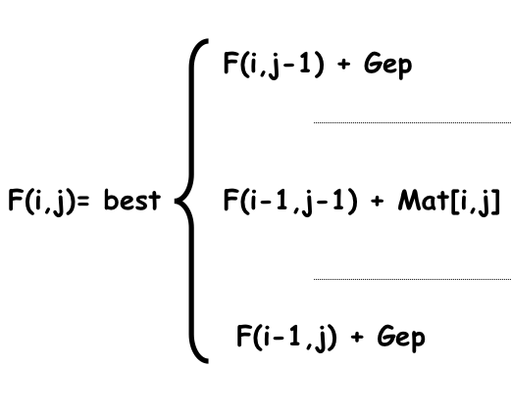
Why?

Slide 50
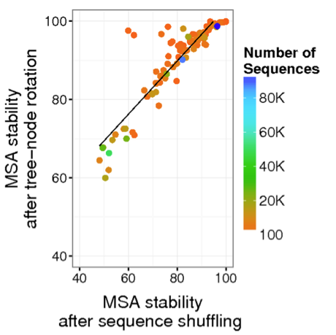
Node Shuffling Explains most of the Input order Variations
For Each Dataset
Take ClustalO Guide Tree
((A,B),(C,D))
Generate a 100 Rotated Replicates
((B,A),(C,D))
((C,D),(A,B))
((C,D),(B,A))
Measure MSA Stability

Slide 51
This Makes a Huge Difference!!!
For N sequences
N! rearrangements
2^{N-1} shuffled trees
10 Seq: 1024 vs 3,620,000
100 Seq: 1.2³⁰ vs 9¹⁵⁷
1000 Seq: Big vs Very Very Big

Slide 52
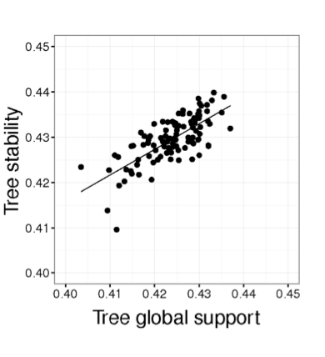
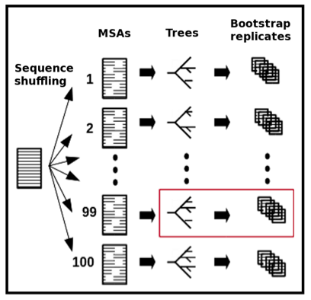
And in Practice ?

Slide 53
And in Practice ?
X
X
X

Slide 54
On Large Datasets, the tree having the highest similarity with the rest of the Shuffle replicates
⬄
Will have a high Bootstrap Support

Slide 55
Conclusion
-MSA stability Gives Branch Reliability Information
-Correlation between MSA support and Global Bootstrap is not perfect
-Best Measure of Branch reliability will probably be a combination between MSA Support and Global Bootstrap

Slide 56
How do We compute all This
???
100 datasets
3 MSA Methods
2 Bootstrap Method
Millions of tree nodes to compare
Nightmare!!!

Slide 59
Who Does All This ?
MSA Stability
Maria Chatzou
Olivier Gascuel (Pasteur Institute, Fr)
NextFlow
Paolo DiTommaso
Emidio Palumbo
Pablo Prieto
Jesus Labarta (BSC)

Slide 60
Two problems in One

Slide 61
Computing even a simple Criterion is NP-Complete
2 sequences 1 minute
3 sequences 2 hours
4 sequences 10 days
5 sequences 3 years
6 sequences 3 centuries
8 sequences 3 million years

Slide 62
It means we have to cheat!
Progressive Alignment
Hogeweg 1984; Feng and Dolittle, 1988; Taylor 1989
Clustering

Slide 63
Progressive Alignment
Dynamic Programming Using A Substitution Matrix

Slide 64
Example of Progressive Failure
CLUSTALW (Score=20, Gop=-1, Gep=0, M=1)
SeqA GARFIELD THE LAST FA-T CAT
SeqB GARFIELD THE FAST CA-T ---
SeqC GARFIELD THE VERY FAST CAT
SeqD -------- THE ---- FA-T CAT
CORRECT (Score=24)
SeqA GARFIELD THE LAST FA-T CAT
SeqB GARFIELD THE FAST ---- CAT
SeqC GARFIELD THE VERY FAST CAT
SeqD -------- THE ---- FA-T CAT

Slide 65
Consistency Based Algorithms

Slide 66
Who is THE Best?

Slide 67
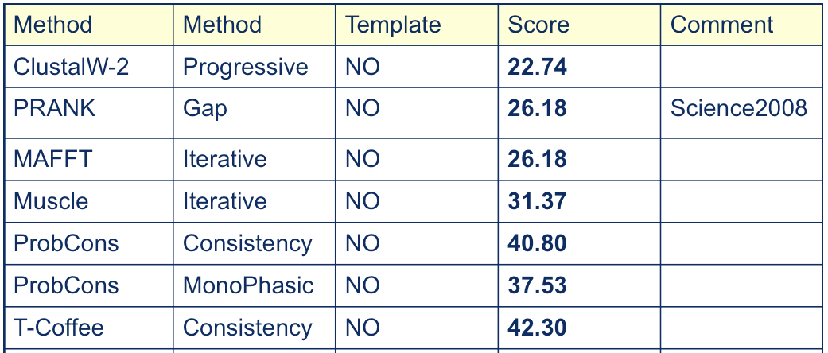
RV11 Benchmark

Slide 68
Structural Modeling

Slide 70
PHYLOGENETIC RECONSTRUCTION

Slide 71
What’s in a Multiple Alignment?

Slide 72
Good MSAs Give Better Distance Estimates
Mutations Rate
Number of Mutations
Number
of
Observed
Mutations
time

Slide 74
My Team Members !!
Jia Ming Chang
Ionas Erb
Maria Chatzou
Jose Espinosa
Pablo Di Tomasso
Carsten Kemena
Pablo Prieto
Cedric Magis
Givanni Bussotti
Cedric Notredame
www.tcoffee.org

Slide 75
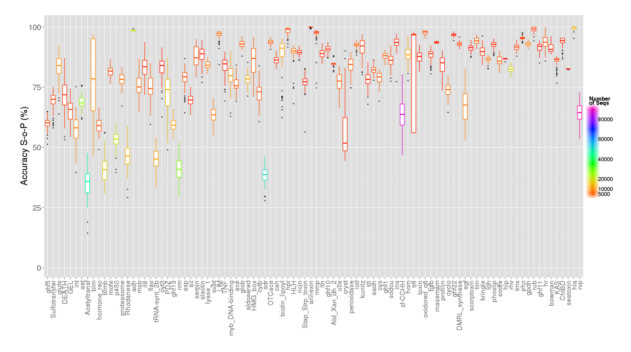

Slide 76
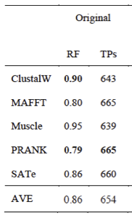
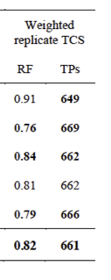
Do Better MSAs give Better Trees ?

Slide 77
ENSEMBL 2008

