Slide 1
Genome
de novo assembly
Cedric Notredame
Adapted from Rayan Chikhi

Slide 2
COURSE STRUCTURE
Short intro
Basic definitions
Fundamentals: why assemblies are as they are
Metrics: methods for evaluation
RNA-Seq: how Trinity works
In practice: best practices ; multi-k ; visualization

Slide 4
What’s an assembly and how to generate one . . .

Slide 5
Source: 8 Ted Talks That Teach Public Speaking (SNI)

Slide 6
THE "WHY"
Create reference genome / transcriptome
Gene content
Novel insertions
Un-mapped reads
SNPs in non-model organisms
Find SV’s
Specific regions of interest
Metagenomics
- ..

Slide 7
"WHAT" AND "HOW" BASED ON "WHY"
Scenario 1:
What the best possible assembly of bacteria X
How high-coverage PacBio data
Why Obtain a reference geome
Scenario 2:
What a meh-looking draft assembly of organism X
How couple of Illumina lanes
Why Gene content and possible viral insertions

Slide 8
ASSEMBLY: A SOLVED PROBLEM?
Still a difficult problem in 2017
PacBio methods are still preliminary
Hard to obtain good assemblies from Illumina data
Conclusions of the GAGE benchmark : in terms of assembly quality, there is no single best assembler
High computational requirements
State of the research
Data-specific assemblers (esp. PacBio)
Efficient assemblers
Best-practice protocols
Assembly-based variant calling

Slide 9
PLAN
What is a de novo assembly Description
Short Exercise
Some useful assembly theory Graphs
Contigs construction Exercise
How to evaluate an assembly Reference-free metrics Exercise
Assembly software DNA-seq assembly RNA-seq assembly
Fresh stuff: multi-k and viz Exercise

Slide 10
Definition of an assembly
(trickier question than it seems)
Set of sequences which best approximate the original sequenced material.

Slide 11
SOME ASSEMBLY INTUITION
An assembly generally is:
smaller than the reference,
fragmented
repeat
repeat
sequenced
reads
ideal world: perfect assembly
missing reads create gaps
repetitions fragment assemblies and reduce total size
13

Slide 12
Some vocabulary:
Read Any sequence that comes out of the sequencer
Paired read read₁, gap ≤ 500 bp, read₂
Mate-pair read₁, gap ≥ 1 kbp, read₂
Single read Unpaired read
k -mer Any sequence of length k
Contig gap-less assembled sequence
Scaffold sequence which may contain gaps (N)

Slide 13
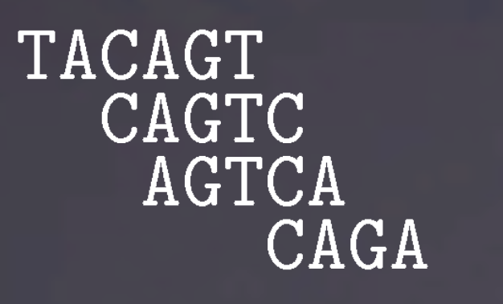
EXERCISE
Here is a set of reads:
❚❆❈❆●❚
❈❆●❚❈
❆●❚❈❆
❈❆●❆
How many k -mers are in these reads (including duplicates), for
k = 3?
How many distinct k -mers are in these reads?
◮ (i) for k = 2
◮ (ii) for k = 3
◮ (iii) for k = 5
Pretend these reads come from the genome TACAGTCAGA. What is the largest k such that the set of distinct k -mers in the genome is exactly the set of distinct k -mers in the reads above?
For any value of k , is there a mathematical relation between N, the number of k -mers (incl. duplicates) in a sequence, and L, the length of that sequence?

Slide 14
EXERCISE (SOLUTION)
Here is a set of reads:
❚❆❈❆●❚
❈❆●❚❈
❆●❚❈❆
❈❆●❆
How many k -mers are in these reads (including duplicates), for
k = 3? 12
How many distinct k -mers are in these reads?
◮ (i) for k = 2 : 7
◮ (ii) for k = 3 : 7
◮ (iii) for k = 5 : 4
Pretend these reads come from the genome TACAGTCAGA. What is the largest k such that the set of distinct k -mers in the genome is exactly the set of distinct k -mers in the reads above? 3; for k=4, TCAG does not appear in the reads
For any value of k , is there a mathematical relation between N, the number of k -mers (incl. duplicates) in a sequence, and L, the length of that sequence? N = L − k + 1

Slide 15
PLAN
What is a de novo assembly Description
Short Exercise
Some useful assembly theory Graphs
Contigs construction Exercise
How to evaluate an assembly Reference-free metrics Exercise
Assembly software DNA-seq assembly RNA-seq assembly
Fresh stuff: multi-k and viz Exercise

Slide 16
GRAPHS
A graph is a set a nodes and a set of edges (directed or not).
a2
a3
a1
a4
a0
a5
a7
a6

Slide 17
GRAPHS FOR SEQUENCING DATA
Overlaps between reads is the fundamental information used to assemble.
Graphs represent these overlaps.
Two different types of graphs for sequencing data:
de Bruijn graphs
string graphs
for Illumina data for PacBio data
A bioinformatician who knows those graphs will understand:
how to set the parameters of an assembler
the type of errors that assemblers make
why variants are lost
why some repetitions are collapsed
why heterozygous regions may appear twice

Slide 18
DE BRUIJN GRAPHS
This is going to be fundamental for Illumina data.
A de Bruijn graph for a fixed integer k :
Nodes = all k-mers (substrings of length k ) present in the reads.
There is an edge between x and y if the (k − 1)-mer prefix of y matches exactly the (k − 1)-mer suffix of x .
Exemple for k = 3 and a single read:
ACTG
ACT
CTG

Slide 19
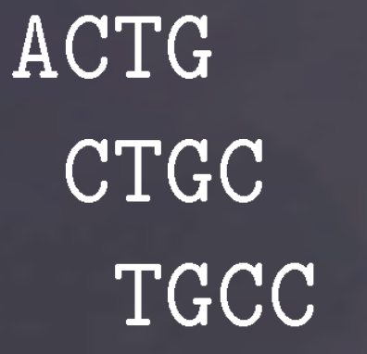
DE BRUIJN GRAPHS
Example for many reads and still k = 3.
❆❈❚●
❈❚●❈
❚●❈❈
ACT
CTG
TGC
GCC

Slide 20
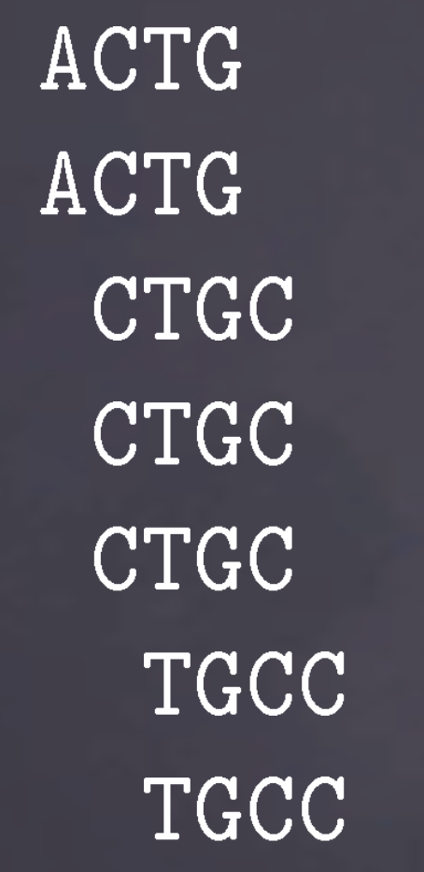
DE BRUIJN GRAPHS: REDUNDANCY
What happens if we add redundancy?
❆❈❚●
❆❈❚●
❈❚●❈
❈❚●❈
❈❚●❈
❚●❈❈
❚●❈❈
dBG, k = 3:
ACT CTG TGC
GCC

Slide 21
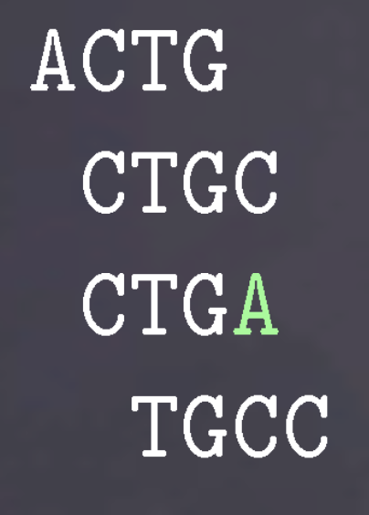
DE BRUIJN GRAPHS: ERRORS
How is a sequencing error (at the end of a read) impacting the de Bruijn graph?
❆❈❚●
❈❚●❈
❈❚●❆
❚●❈❈
dBG, k = 3:
ACT CTG TGC GCC
TGA

Slide 22
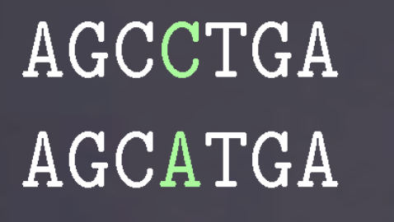
DE BRUIJN GRAPHS: SNPS
What is the effect of a SNP (or a sequencing error inside a read) on the graph?
❆●❈❈❚●❆
❆●❈❆❚●❆
dBG, k = 3:
GCC CCT CTG
AGC
TGA
GCA
CAT
ATG

Slide 23
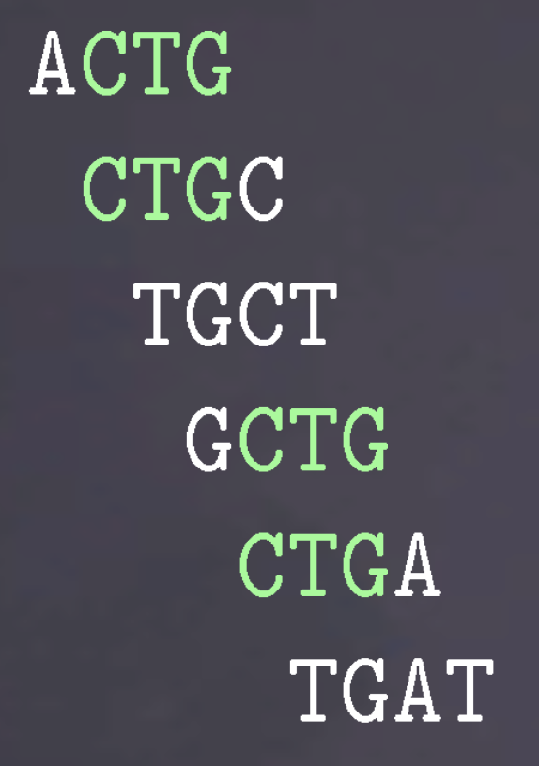
DE BRUIJN GRAPHS: REPEATS
What is the effect of a small repeat on the graph?
❆❈❚●
❈❚●❈
❚●❈❚
●❈❚●
❈❚●❆
❚●❆❚
dBG, k = 3:
ACT CTG TGC
GAT
TGA
GCT

Slide 24
STRING GRAPHS: OVERLAP GRAPHS
This is going to be fundamental for PacBio data.
Definition of an overlap graph. It is almost a string graph.
Nodes = reads.
Two nodes are linked by an edge if both reads overlap¹. Example for k = 3 and a single read: ACTG
ACTG
¹The definition of overlap is voluntarily fuzzy, there are many possible definitions.

Slide 25
OVERLAP GRAPHS
Let’s fix an overlap definition:
We say that r and r ′ overlap if a suffix of r of length ℓ > k (for some fixed k ) is exactly a prefix of r ′ of similar length.
Overlap graph for k = 3,
❆❈❚●❈❚
❈❚●❈❚ (overlap of length 5)
●❈❚❆❆ (overlap of length 3)
ACTGCT CTGCT
GCTAA

Slide 26
STRING GRAPHS: OVERLAP GRAPHS
A string graph is obtained from an overlap graph by removing redundancy:
redundant reads (those fully contained in another read)
transitively redundant edges (if a → c and a → b → c, then remove a → c)

Slide 27
FROM OVERLAP GRAPHS TO STRING GRAPHS
Overlap graph for k = 3,
ACTGCT
CTGCT
GCTAA
String graph for k = 3,
ACTGCT
GCTAA
The read CTGCT is contained in ACTGCT, so it is redundant

Slide 28
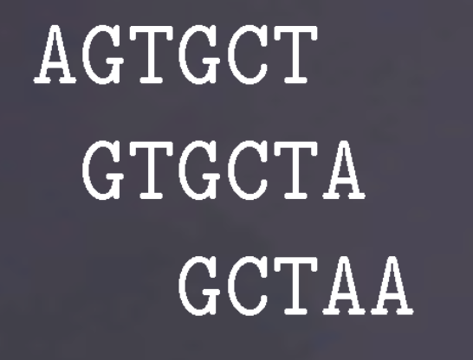
COMPARISON STRING GRAPH / DE BRUIJN
GRAPH
On the same example, compare the de Bruijn graph with the string graph:
❆●❚●❈❚
●❚●❈❚❆
●❈❚❆❆
String graph, k = 3:
AGTGCT
GTGCTA
GCTAA
de Bruijn graph, k = 3:
AGT GTG
TGC
GCT
CTA
TAA

Slide 29
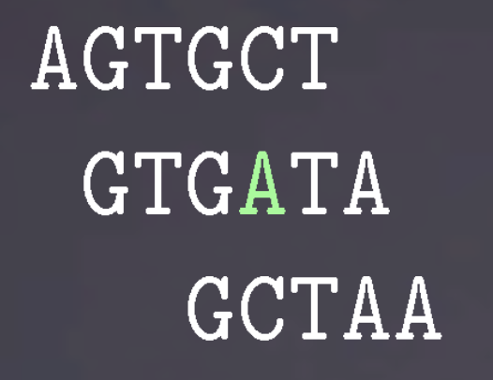
STRING GRAPH / DE BRUIJN GRAPH (2)
Let’s add an error:
❆●❚●❈❚
●❚●❆❚❆
●❈❚❆❆
String graph, k = 3:
AGTGCT GTGATA GCTAA
de Bruijn graph, k = 3:
AGT GTG
TGC
GCT
CTA
TAA
TGA
GAT
ATA

Slide 30
STRING GRAPH / DE BRUIJN GRAPH (3)
How to "fix" the string graph?
→ use a relaxed definition of overlaps.
String graph where overlaps may ignore 1 error, k = 3:
AGTGCT GTGATA GCTAA
de Bruijn graph, k = 3:
AGT GTG
TGC
GCT
CTA
TAA
TGA
GAT
ATA

Slide 31
STRING GRAPH / DE BRUIJN GRAPH (4)
So, which is better?
String graphs capture whole read information
de Bruijn graphs are conceptually simpler:
◮ single node length
◮ single overlap definition
Historically, string graphs were used for long reads and de Bruijn graphs for short reads.
String graphs are also known as the Overlap Layout Consensus (OLC) method.

Slide 32
HOW DOES ONE ASSEMBLE USING A GRAPH?
Assembly in theory
[Nagarajan 09]
Return a path of minimal length that traverses each node at least once.
Illustration
CAT
GAT
ATT
TTA
TAC
ACA
CAA
The only solution is

Slide 33
An ambiguous assembly graph
GAG AGT
GTG
ACT
CTG
TGA
GAC
ACC
GAA AAT ATG
Because of ambiguities and low-coverage regions, a single path is almost never found is theory, and is really never found in practice.
Assembly in practice
Return a set of paths covering the graph, such that all possible assemblies
contain these paths.
Assembly of the above graph
An assembly is the following set of paths:
{❆❈❚●❆, ●❆❈❈, ●❆●❚●, ●❆❆❚●}

Slide 34
CONTIGS CONSTRUCTION
Contigs are node-disjoint simple paths.
simple path: a path that does not branch.
node-disjoint: two different paths cannot share a node.
Contig 1
Contig 3
Contig 4
Contig 2
Contig 5

Slide 35
HOW AN ASSEMBLER WORKS
[SPAdes, Velvet, ABySS, SOAPdenovo, SGA, Megahit, Minia, .., HGAP, FALCON]
Maybe correct the reads. (SPAdes, HGAP, SGA, FALCON)
Construct a graph from the reads.
Assembly graph with variants & errors
2.1) Likely sequencing errors are removed. (not in FALCON)
Known biological events are removed. (not in FALCON)
Finally, simple paths (i.e. contigs) are returned.
2 2 2
1 1 1 1
3 3 3
2
3

Slide 36
SHORT NOTE ON REVERSE COMPLEMENTS
Because sequencing is generally not strand-specific:
In assembly, we always consider reads (and k-mers) are equal to their reverse complements.
E.g:
AAA = TTT ATG = CAT

Slide 37
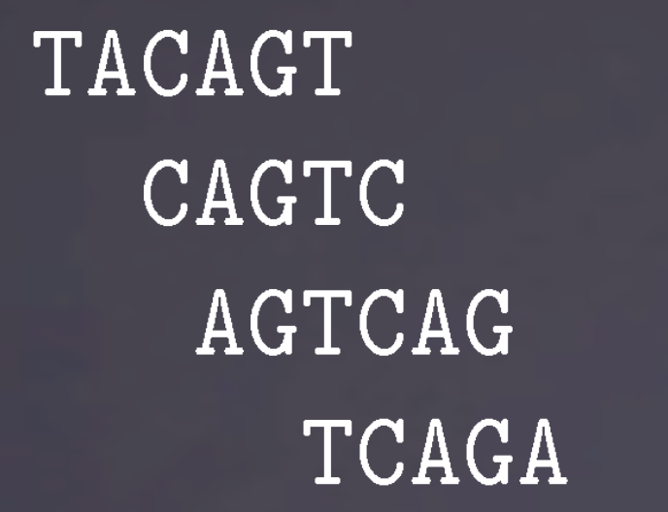
EXERCISE
In this exercise, for simplicity, ignore reverse complements.
Reads:
❚❆❈❆●❚
❈❆●❚❈
❆●❚❈❆●
❚❈❆●❆
Construct the de Bruijn graph for k = 3. (Reminder: nodes are k -mers and edges correspond to (k − 1)-overlaps)
How many contigs can be created?
At which value of k is there a single contig?
(optional) Find a mathematical relationship between k_{a}, the smallest k value with which a genome can be assembled into a single contig (using a de Bruijn graph), and ℓ_{r} , the length of the longest exactly repeated region in that genome.

Slide 38
EXERCISE (SOLUTION)
In this exercise, for simplicity, ignore reverse complements. Reads:
❚❆❈❆●❚
❈❆●❚❈
❆●❚❈❆●
❚❈❆●❆
1. Construct the de Bruijn graph for k = 3.
The 3-mers (nodes) are: TAC, ACA, CAG, AGT, GTC, TCA, AGA
TAC
ACA
CAG
AGT
GTC
TCA
AGA
How many contigs can be created? 3
At which value of k is there a single contig? 5
Find a mathematical relationship between ka, the smallest k value with which a genome can be assembled into a single contig (using a de Bruijn graph), and ℓr , the length of the longest exactly repeated region
in that genome. ka = ℓr + 1

Slide 39
PLAN
What is a de novo assembly Description
Short Exercise
Some useful assembly theory Graphs
Contigs construction Exercise
How to evaluate an assembly Reference-free metrics Exercise
Assembly software DNA-seq assembly RNA-seq assembly
Fresh stuff: multi-k and viz Exercise

Slide 40
METRICS
Preamble: There is no trivial total order (i.e. ranking) between assemblies.
Why? > 2 independent criteria to optimize (e.g., total length, and average size of assembled sequences)
Example Would you rather have an assembly with high coverage and short contigs, or an assembly with low coverage and long contigs?

Slide 41
OVERVIEW OF REFERENCE-FREE METRICS
Individually evaluate a single assembly
Compare several assemblies made from different parameters or assemblers
Classical metrics:
Number of contigs/scaffolds
Total length of the assembly
Length of the largest contig/scaffold
Percentage of gaps in scaffolds (’N’)
N50/NG50 of contigs/scaffolds
Number of predicted genes
Number of core single-copy genes
[QUAST]
[BUSCO]

Slide 42
REFERENCE-FREE METRICS: N50
N50 = Largest contig length
NG50 = Largest contig length at which that contig and longer contigs cover 50% of the total genome length
at which that contig and longer contigs cover 50% of the total assembly length
A practical way to compute N50:
Sort contigs by decreasing lengths
Take the first contig (the largest): does it cover 50% of the assembly?
If yes, its length is the N50 value.
Else, consider the two largest contigs, do they cover 50%?
If yes, then the N50 is the length of the second largest contig.
And so on..

Slide 43
REFERENCE-BASED: NA50
The best metric no-one has heard of.
ref
assembly
aligned assembly
Align contigs to reference genome.
Break contigs at misassembly events and remove unaligned bases.
Compute N50/NG50 of the result.

Slide 44
OTHER METRICS OF INTEREST
Internal consistency : Percentage of paired reads correctly aligned back to the assembly (happy pairs).
Can pinpoint certain misassemblies (mis-joins).
REAPR
FRCurve
[M Hunt, .. (Gen. Biol.) 2013]
[F. Vezzi, .. (Plos One) 2013]
Assembly Likelihood : ^{Q}_{i} p(r_{i} |A), where p(r_{i} |A) is the probability that read r_{i} is sequenced if the genome was A
In practice, p(r_{i} |A) is estimated by aligning r_{i} to the assembly.
ALE
CGAL
LAP
[Clark, (Bioinf.) 2013] [Rahman, (Gen. Biol.) 2013] [Ghodsi, (BMC Res. Notes) 2013]

Slide 45
ASSEMBLY LIKELIHOOD
ALE plot of likelihood windows over the E. coli genome.

Slide 46
EXERCISE
At some point in life, one may need to compare assemblies.
Here are two assemblies, aligned to the same reference:
- For each, compute the following metrics:
◮ Total size of the assembly, N50, NG50 (bp)
◮ Coverage (%)
- Which one is better than the other?

Slide 47
EXERCISE (SOLUTION)
For each, compute the following metrics:
◮ Total size of the assembly (19 bp, 18 bp), N50 (6 bp, 9 bp), NG50 (6 bp, 5 bp)
◮ Coverage (%) (90, 90)
Which one is better than the other? (I would say first one: higher NG50, less contigs, same coverage as the other. But: has some redundancy.)

Slide 48
PLAN
What is a de novo assembly Description
Short Exercise
Some useful assembly theory Graphs
Contigs construction Exercise
How to evaluate an assembly Reference-free metrics Exercise
Assembly software DNA-seq assembly RNA-seq assembly
Fresh stuff: multi-k and viz Exercise

Slide 49
RECOMMENDED PRACTICES (GENOMES)
PacBio whenever you can.
- Illumina:
◮ Longest read lengths
◮ ≤ 50x coverage, × ploidy number.
◮ For 1 bacterial genome, no point going above ≈ 200x .
◮ Broad recipe: several mate pairs libraries of increasing size
◮ grey area for assembly software. Mostly de Bruijn graphs.
- PacBio:
◮ Latest chemistry
◮ At least 50x too, for now.
◮ Use PacBio’s string graph assemblers.

Slide 50
ASSEMBLERS, PERSONAL EXPERIENCE
Most genomes SPAdes
Data following the Broad recipe Discovar de novo
Memory issues Minia
PacBio FALCON
RNA-Seq Trinity
Large metagenomes Megahit

Slide 51
META-PRACTICES
Read either the GAGE-B paper (Illumina, bacteria), Assemblathon 2 (large genomes), HGAP paper (PacBio, bacteria), Twitter/blogs (PacBio and metagenomes)
Pick two assemblers
Run each assembler at least two times (different parameters)
Compare assemblies
If possible, visualize them

Slide 52
RNA-SEQ AND ASSEMBLY
Goal: reconstruct mRNA sequences

Slide 53
RNA-SEQ ASSEMBLY
Short contigs
Uneven coverage
Contigs are re-used
average mRNA length: 2 kbp varying expression levels alternative splicing

Slide 54
RNA-SEQ ASSEMBLY
Despite these differences, DNA-seq assembly methods apply:
Construct a de Bruijn graph
Output contigs
(same as DNA) (same as DNA)
- Allow to re-use the same contig in many different
transcripts
(new part)

Slide 55
RNA-SEQ ASSEMBLY: TRINITY
Quick overview of Trinity steps:
Inchworm
Chrysalis
Butterfly

Slide 56
RNA-SEQ ASSEMBLY: TRINITY
Inchworm de Bruijn graph construction, part 1
Chrysalis de Bruijn graph construction, part 2, then partitioning
Butterfly Graph traversal using reads, isoforms enumeration

Slide 57
RNA-SEQ ASSEMBLY: TRINITY - 1
- Inchworm
Using k-mers, construct contigs carelessly.
Contigs might correspond to the most abundant isoform, but no guarantee.

Slide 58
RNA-SEQ ASSEMBLY: TRINITY - 2
- Chrysalis
Overlap Inchworm contigs to construct the true de Bruijn graph.
Then,
Partition the graph and output the reads aligning to each partition.

Slide 59
RNA-SEQ ASSEMBLY: TRINITY - 3
- Butterfly
Traverse each de Bruijn graph partition to output isoforms
Difference with DNA-seq assembly: isoforms are, by definition, not k -mer-disjoint.

Slide 60
MULTI-K ASSEMBLY
Input reads
Assembler Assembler
k=21 k=55
Assembler
k=77
Final assembly
Always better than single-k assembly.
Assemblers that implement multi-k:
- IDBA, SPAdes, Megahit, GATB-Pipeline

Slide 61
MULTI-K ASSEMBLY
Input reads
Assembler Assembler
k=21 k=55
Assembler
k=77
Final assembly
Always better than single-k assembly.
Assemblers that implement multi-k:
- IDBA, SPAdes, Megahit, GATB-Pipeline
It’s 2016! why are we still doing single-k assembly?

Slide 62
ILLUMINA ASSEMBLY VISUALIZATION: BANDAGE

Slide 63
BANDAGE
E. coli SPAdes assembly (excerpt). Fig from Lex Nederbragt. What is this knot?

Slide 64
BANDAGE
E. coli SPAdes assembly (excerpt). Fig from Lex Nederbragt. What is this knot?
collapsed ribosomal genes (16S, 2S, ..)
66

Slide 65
PACBIO ASSEMBLY VISUALIZATION: FALCON2FASTG
Mitochondrial genome string graph. Apparently 4 chromosomes. Each node is a read.
(fig. courtesy of @md5sam, data from EEP Lille)

Slide 66
PACBIO ASSEMBLY VISUALIZATION: FALCON2FASTG
D. melanogaster FALCON assembly. Each node is a contig. (fig. courtesy of
@md5sam)

Slide 67
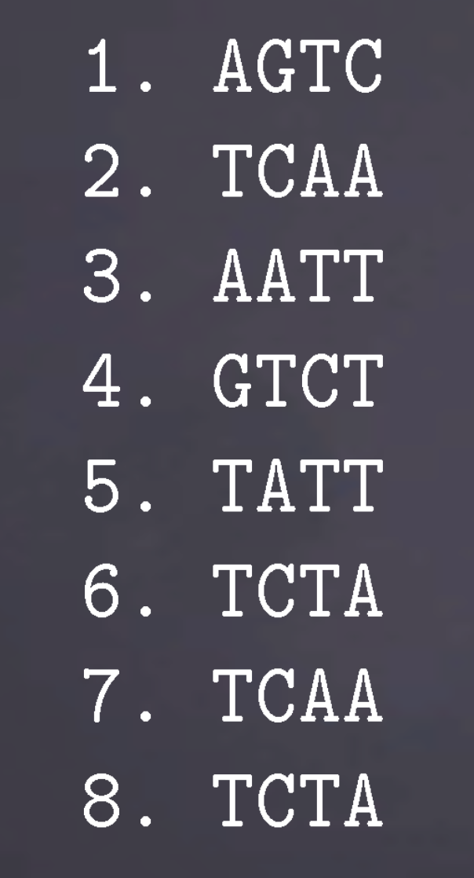
LAST EXERCISE
Reads:
✶✳ ❆●❚❈
✷✳ ❚❈❆❆
✸✳ ❆❆❚❚
✹✳ ●❚❈❚
✺✳ ❚❆❚❚
✻✳ ❚❈❚❆
✼✳ ❚❈❆❆
✽✳ ❚❈❚❆
Assemble these reads
What was special about this genome?

Slide 68
LAST EXERCISE (DETAILED SOLUTION)
Step by step:
Choose an assembly model: de Bruijn graph or string graph
The reads are short, let’s choose the de Bruijn model
Choose a k-mer size:
Tempting to use k = 4, as it is the highest value such that k-mers exist in the reads. However, to obtain a good assembly, all 4-mers from the (unknown) sequenced genome need to be seen in the reads. This is a risky bet. Hence, let’s pick a smaller k, k = 3.
The nodes of the graph are all the distinct 3-mers in the reads: AGT, GTC, TCA, CAA, AAT, ATT, TCT, TAT, CTA
With an appropriate layout, the graph is:
TCA
CAA
AAT
AGT
GTC
ATT
TCT
CTA
TAT

Slide 69
LAST EXERCISE (DETAILED SOLUTION)
TCA
CAA
AAT
AGT
GTC
ATT
TCT
CTA
TAT
To assemble this graph, using the contigs construction used before, there would be 4 contigs. Depending on how branching nodes are included in contigs, a possible solution is: AGTC, TCAAT, TCTAT, ATT.
But we can actually do better. There are two ways to traverse this graph, yielding an assembly of two "haplotypes":
❆●❚❈❆❆❚❚
❆●❚❈❚❆❚❚
This could be a tiny diploid genome with an heterozygous SNP. The bubble is unlikely to be a sequencing error, as I have purposely added reads 7 and 8, which make the k -mer coverage of both paths equally high.
An assembler would collapse this bubble and output only one of the two haplotypes.

Slide 70
CONCLUSION, WHAT WE HAVE SEEN
- What is a good assembly?
◮ No total order
◮ Main metrics: N50, coverage, accuracy
◮ Use QUAST
- How are assemblies made?
◮ Using a de Bruijn graph (Illumina) or a string graph (PacBio)
◮ Errors and small variants are removed from the graph.
◮ Contigs are just simple paths from the graph.
◮ Scaffolds are linked contigs, misassemlies often happen there.
Assembly software
◮ Illumina: SPAdes (≤ 100 Mbp genomes). For larger genomes, it’s unclear.
◮ PacBio: FALCON
A few tips
◮ Try another assembler
◮ Try different parameters
◮ An assembly is not the absolute truth, it is a mostly complete, generally fragmented and mostly accurate
hypothesis

Slide 71
SUPPLEMENTAL SLIDE: ASSEMBLY PIPELINES
No Adapters
Correction
Diginorm
KmerGenie PreQC
Assembler
Scaffolder
Gapfiller
Annotation

