Slide 1
Metagenomic assembly
Cedric Notredame
(adpapted from Daan Speth and Bas Dutilh)

Slide 2
This morning
Short intro Assembly
Data quality check, preprocessing and assembly
Binning
Binning: sequencing depth, GC content and ESOM
Questions and concluding remarks

Slide 3
different datasets, different approaches
Selective environment (low to moderate diversity)
Mostly macrodiversity (e.g WWTP,
enrichments, deepsea)
De novo Assembly Genome binning & analysis
Mostly microdiversity (e.g. cheese
starter cultures)
(Isolation & sequencing) Mapping
Metagenome
High diversity (soil/sediments/ eukaryotes)
MG-RAST/MEGAN/etc
Marker gene search
‘community metabolic potential’

Slide 4
different datasets, different approaches
Selective environment Mostly macrodiversity De novo Assembly (low to moderate (e.g WWTP, Genome binning & diversity) enrichments, deepsea) analysis
^{Mostly microdiversity} (Isolation & sequencing)
(e.g. cheese _{Mapping}
^{Metagenome} starter cultures)
High diversity ^{MG-RAST}
(soil/sediments/ ^{BLAST}
_{eukaryotes)} ‘community metabolic potential’
Based on what you know about the sample,
you can make a good guess what you can get out of a metagenome
(and if that’s worth it)

Slide 5
different datasets, different approaches
Selective environment (low to moderate diversity)
Mostly macrodiversity (e.g WWTP,
enrichments, deepsea)
De novo Assembly Genome binning & analysis
Mostly microdiversity (e.g. cheese
starter cultures)
(Isolation & sequencing) Mapping
Metagenome
High diversity (soil/sediments/ eukaryotes)
MG-RAST/MEGAN/etc
Marker gene search
‘community metabolic potential’

Slide 6
Which dataset to assemble?
Selective environment (low to moderate diversity)
Mostly macrodiversity (e.g WWTP,
enrichments, deepsea)
De novo Assembly Genome binning & analysis
Mostly microdiversity (e.g. cheese
starter cultures)
(Isolation & sequencing) Mapping
Metagenome
High diversity (soil/sediments/ eukaryotes)
MG-RAST/MEGAN/etc
Marker gene search ‘community metabolic potential’

Slide 7
How can you know?: Kmer counting
count
count
Kmer abundance
Kmer abundance

Slide 8
This morning
Short intro Assembly
Data quality check, preprocessing and assembly
Binning
Binning: sequencing depth, GC content and ESOM
Questions and concluding remarks

Slide 9
From metagenomic contigs to draft genomes

Slide 10
The problem
Binning:
clustering sequences with the same origin together
A corner piece? GREAT! But where is the rest of the puzzle?
Drew Sheneman, New Jersey -- The Newark Star Ledger

Slide 11
Data handles
Prior knowledge (Databases)
Sequence composition
Sequence abundance

Slide 12
Data handles: databases

Slide 13
Data handles: composition
Limited chemical signature
Biological information
- Codon usage (tetramer frequency)
‘Unique’ long k-mers Contig/read length matters!

Slide 14
Data handles: abundance
Abundance in the sample correlates with abundance in reads
library preparation
sequencing and assembly

Slide 15
Many roads try to get to Rome
Reference based and reference independent binning methods
Mande, S. S., Mohammed, M. H. & Ghosh, T. S. Classification of metagenomic sequences: methods and challenges. Briefings in Bioinformatics 13, 669–681 (2012).

Slide 16
Many roads try to get to Rome
Composition:
GC content
Tetranucleotide frequencies
Abundance
Long k-mer copy number
Contig coverage
Content
Essential single copy genes
Mande, S. S., Mohammed, M. H. & Ghosh, T. S. Classification of metagenomic sequences: methods and challenges. Briefings in Bioinformatics 13, 669–681 (2012).

Slide 17
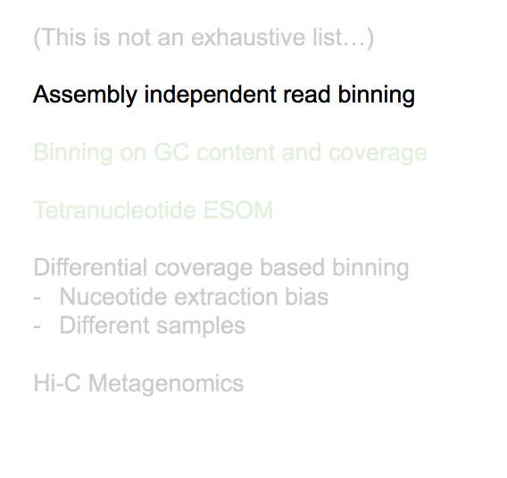
Binning approaches
(This is not an exhaustive list…)

Slide 18
Assembly independent binning
T = long kmer abundance
w = long kmer length
Wang, Y., Leung, H. C. M., Yiu, S. M. & Chin, F. Y. L. MetaCluster 5.0: a two- round binning approach for metagenomic data for low-abundance species in a noisy sample. Bioinformatics 28, i356–i362 (2012).

Slide 19
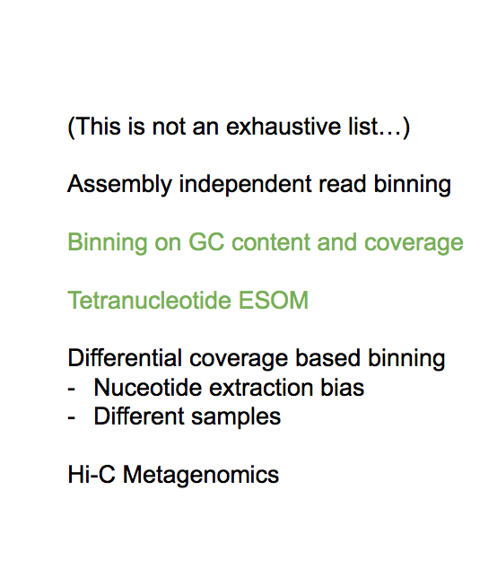
Binning approaches
(This is not an exhaustive list…) Assembly independent read binning
Tetranucleotide ESOM
Differential coverage based binning
Nuceotide extraction bias
Different samples
Hi-C Metagenomics

Slide 20
De novo assembly
Very highly enriched sample:
94% of reads used in assembly

Slide 21
Separating genomes: binning
Binning based on coverage and GC content
Sequencing depth
GC content

Slide 22
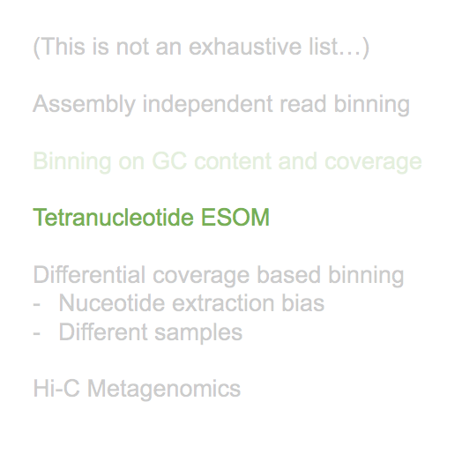
Binning approaches
(This is not an exhaustive list…) Assembly independent read binning Binning on GC content and coverage
Differential coverage based binning
Nuceotide extraction bias
Different samples
Hi-C Metagenomics

Slide 23
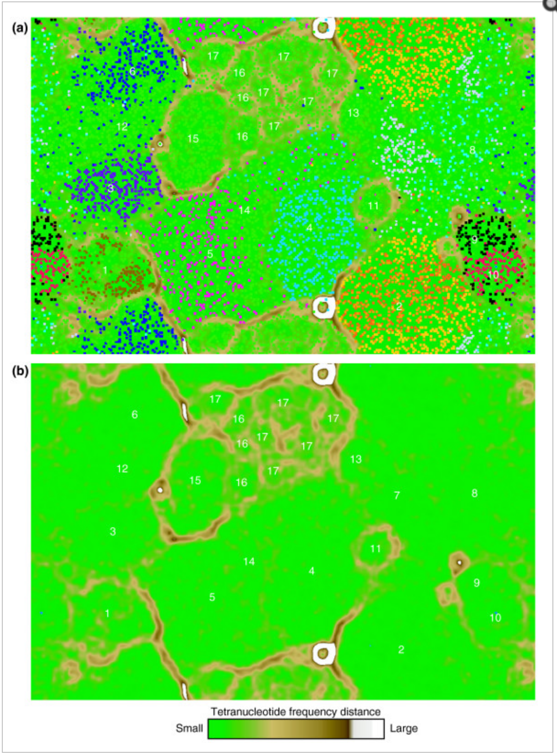
Binning: tetranucleotide ESOM
ESOM of genomic sequence fragments based on tetranucleotide frequency (5-kb window size; all contigs > 2 kb were considered). Note that the map is continuous from top to bottom and side to side. (a) Each point represents a sequence fragment; sequences whose origin is known (from assembly information) are colored as indicated below. Unassigned sequences are shown in green. (b) Topography (U-Matrix) representing the structure of the underlying tetranucleotide frequency data from (a). 'Elevation' represents the difference in tetranucleotide frequency profile between nodes of the ESOM matrix (see legend); high 'elevations' (brown, white) indicate large differences in tetranucleotide frequency and thus represent natural divisions between taxonomic groups.
Dick, G. J., Andersson, A. F., Baker, B. J. & Simmons, S. L. Community-wide analysis of microbial genome sequence signatures. Genome Biology (2009).

Slide 24
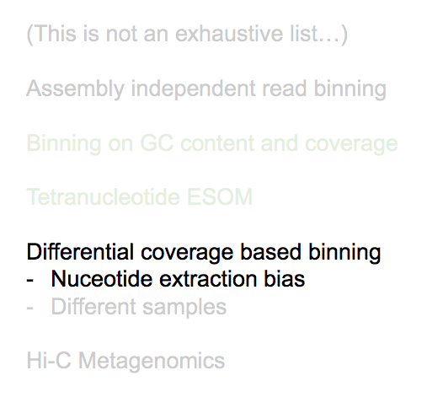
Binning approaches
(This is not an exhaustive list…) Assembly independent read binning Binning on GC content and coverage Tetranucleotide ESOM
- Different samples
Hi-C Metagenomics

Slide 25
Binning: differential coverage binning
Using nucleotide extraction bias to separate organisms
Albertsen, M. et al. Genome sequences of rare, uncultured bacteria obtained by differential coverage binning of multiple metagenomes. Nat Biotechnol 31, 533–538 (2013).

Slide 26
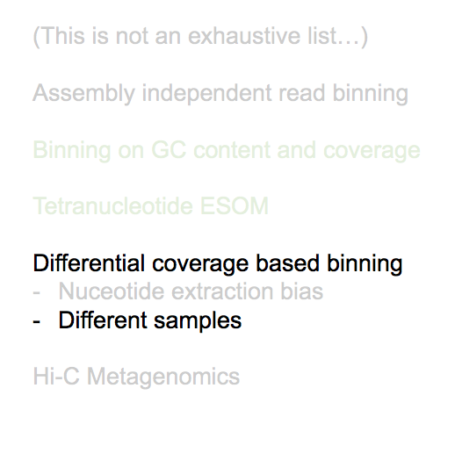
Binning approaches
(This is not an exhaustive list…) Assembly independent read binning Binning on GC content and coverage Tetranucleotide ESOM

Slide 27
Binning: differential coverage binning
Using ‘abundance’ (coverage) in different samples to separate genomes
Alneberg, J. et al. CONCOCT: Clustering cONtigs on COverage and ComposiTion. (2013).
Dutilh, B. E. et al. Reference-independent comparative metagenomics using cross-assembly: crAss. Bioinformatics 28, 3225–3231 (2012).

Slide 28
Binning: differential coverage binning
Using ‘abundance’ (coverage) in different samples to separate genomes
Alneberg, J. et al. CONCOCT: Clustering cONtigs on COverage and ComposiTion. (2013).
Dutilh, B. E. et al. Reference-independent comparative metagenomics using cross-assembly: crAss. Bioinformatics 28, 3225–3231 (2012).

Slide 29
Binning approaches
(This is not an exhaustive list…) Assembly independent read binning Binning on GC content and coverage
Tetranucleotide ESOM
Differential coverage based binning
Nuceotide extraction bias
Different samples

Slide 30
Binning: Hi-C metagenomics
Determining what belongs together by crosslinking total cell content
Beitel, C. W. et al. Strain- and plasmid-level deconvolution of a synthetic metagenome by sequencing proximity ligation products. (2014). doi:10.7287/ peerj.preprints.260v1

Slide 31
Binning: Hi-C metagenomics
Clustering by organism (and even replicon!)
Beitel, C. W. et al. Strain- and plasmid-level deconvolution of a synthetic metagenome by sequencing proximity ligation products. (2014). doi:10.7287/ peerj.preprints.260v1

Slide 32
Binning: concluding remarks
When analyzing a complex community,
experimental design largely determines how much
you can get out

